Slide 1
FUNCTION JAVA-SCRIPT

Slide 2
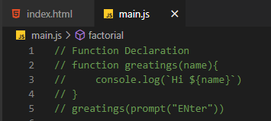
Function – Declaration
A function is declared using the function keyword.
• The basic rules of naming a function are similar to naming a variable. It is better to write a descriptive name for your function. For example, if a function is used to add two numbers, you could name the function add or addNumbers.

Slide 3
Function – Declaration
A function can also be declared with parameters. A parameter is a value that is
passed when declaring a function.
The return statement can be used to return the value to a function call.
The return statement denotes that the function has ended. Any code
after return is not executed.
If nothing is returned, the function returns an undefined value.

Slide 4

Function – Expression
Variable x is used to store the function. Here the function is treated as an expression. And the function is called using the variable name.

Slide 5
Scope
The building our represents program's nested scope ruleset. The first floor of the building represents your currently executing scope, wherever you are. The top level of the building is the global scope.
Scope – Lexical Scope
Lexical scope is scope that is defined at lexing time. In other words, lexical scope is based on where variables and blocks of scope are authored, by you, at write time, and thus is(mostly) set in stone by the time the lexer processes your co

Slide 6
Scope –Global Scope
A variable declared at the top of a program or outside of a function is
considered a global scope variable.
Scope – Local Scope
The variable can also have a local scope, it can only be accessed within a function.In the below program, variable a is a global variable and variable b is a local variable. The variable b can be accessed only inside the greet function. Hence, when we try to access variable b outside of the function, an error occurs.

Slide 7
Hoisting – Variable
There’s a temptation to think that all of the code you see in a
JavaScript program is interpreted line-by-line, top-down in order, as the
Program execute. While that is essentially true, there’s one part of that
as‐assumption that can lead to incorrect thinking about your program.

Slide 8
Hoisting – Function Declaration
So, one way of thinking, sort of metaphorically, about this process, is
that variable and function declarations are “moved” from where they
appear in the flow of the code to the top of the code. This gives rise to
the name hoisting.
The function foo’s declaration (which in this case includes the implied value of it as an actual function) is hoisted, such that the call on the first line is able to execute.

Slide 9
Recursion
Recursion is a process of calling itself. A function that calls itself is called a recursive function.
A recursive function must have a condition to stop calling itself. Otherwise, the function is called indefinitely.
Once the condition is met, the function stops calling itself. This is called the base condition.
To prevent infinite recursion, you can use if...else statement (or similar approach) where one branch makes the recursive call, and the other doesn’t .

Slide 10
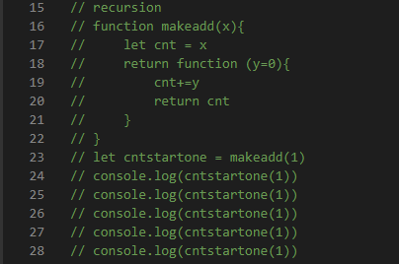

Slide 11
Closure
Closure is one of the most important, and often least
understood, concepts in JavaScript. You can think of closure as a way to
“remember” and continue to access a function’s scope (its variables) even once the function has finished running.

